Slide 1
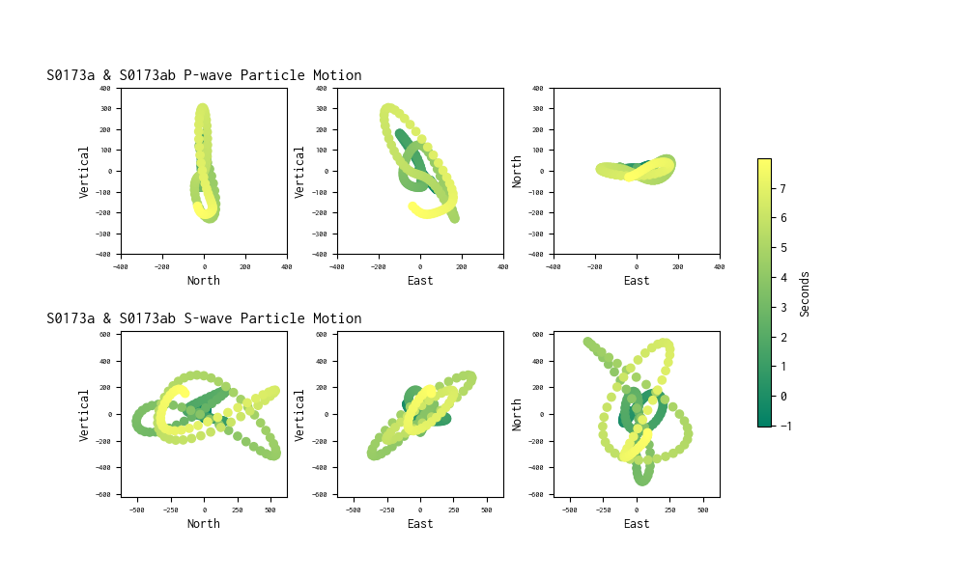
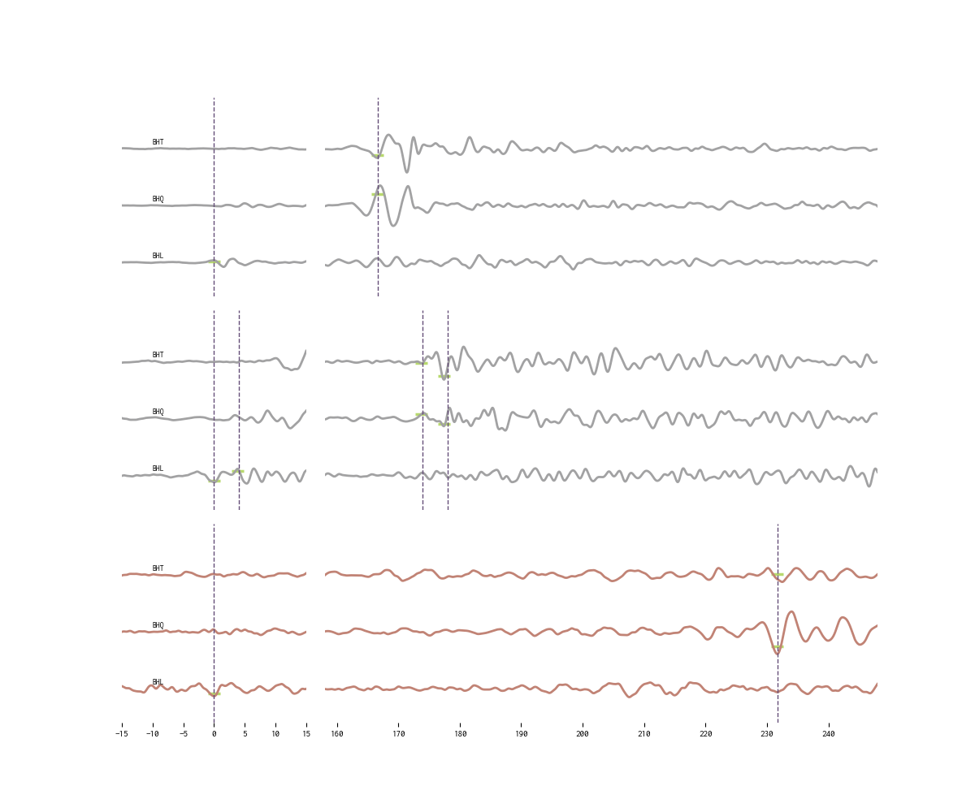
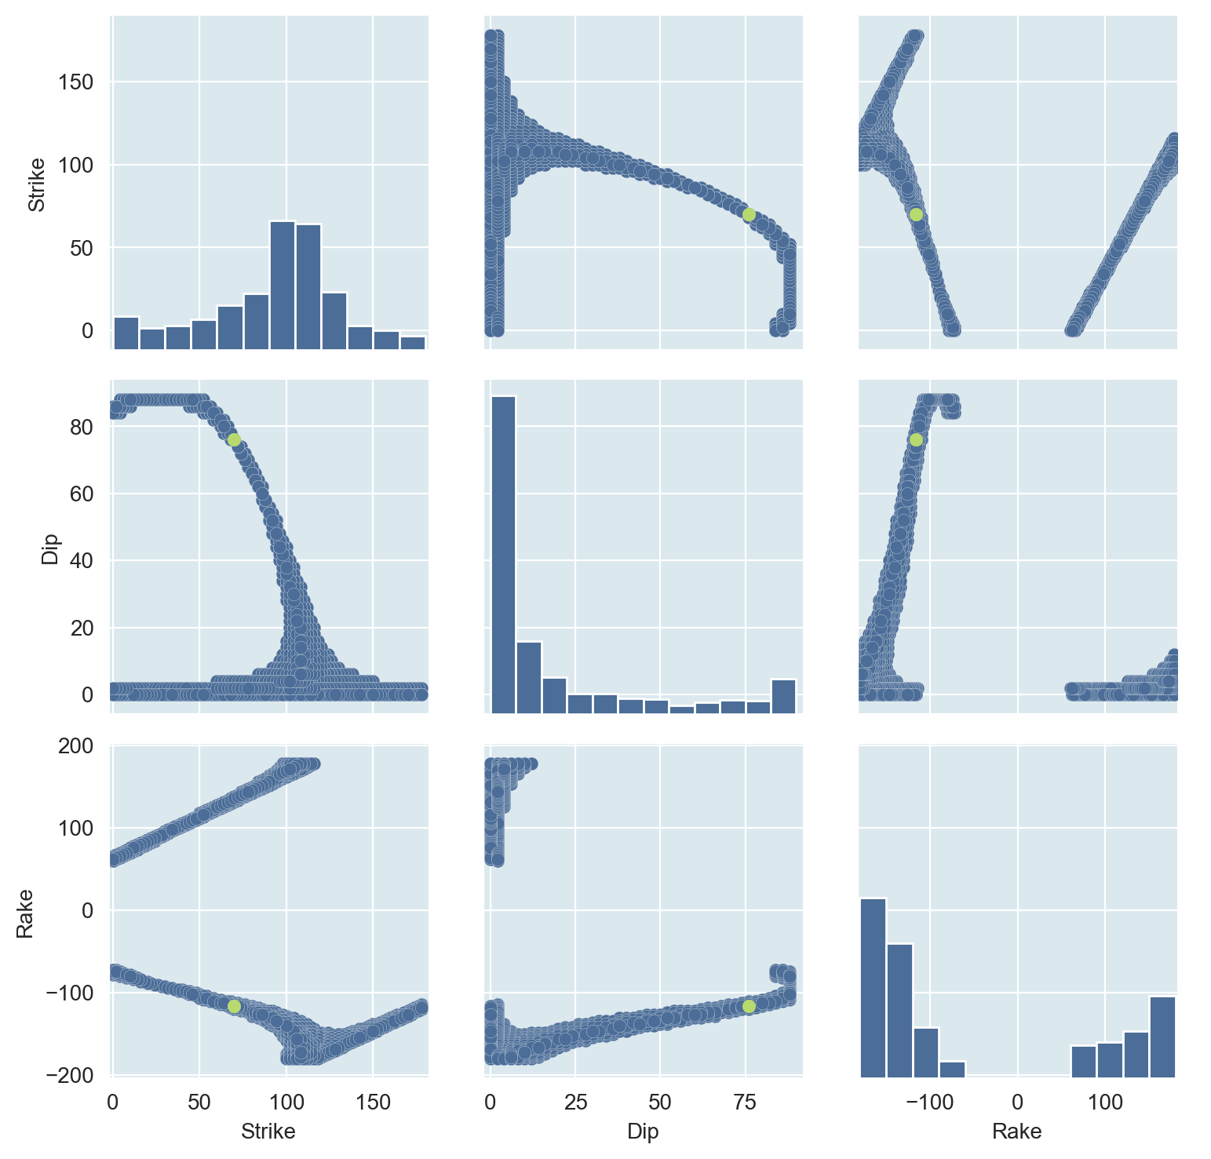
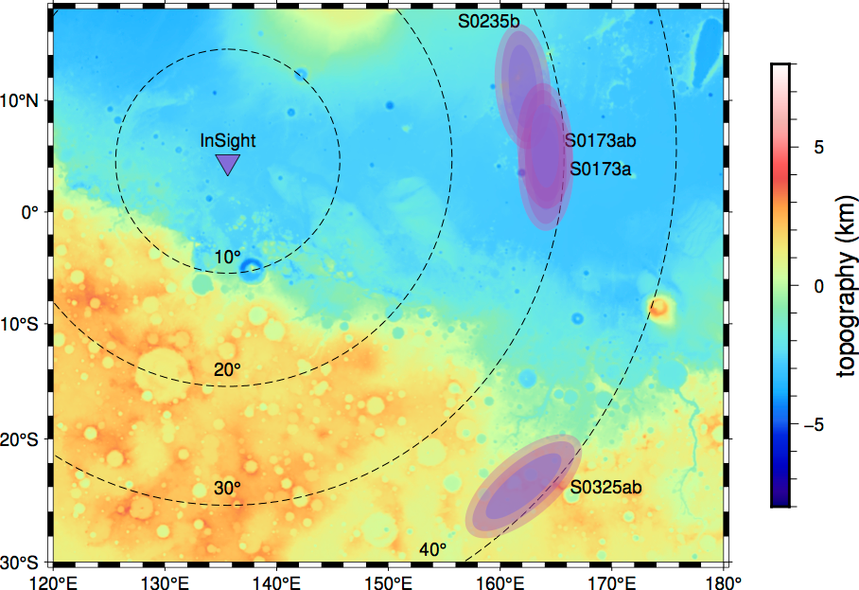
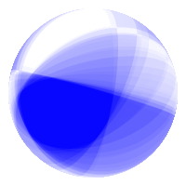
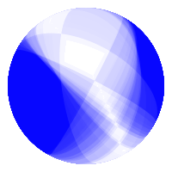
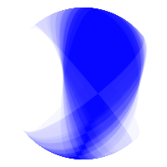
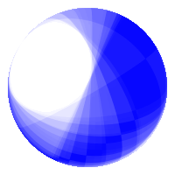




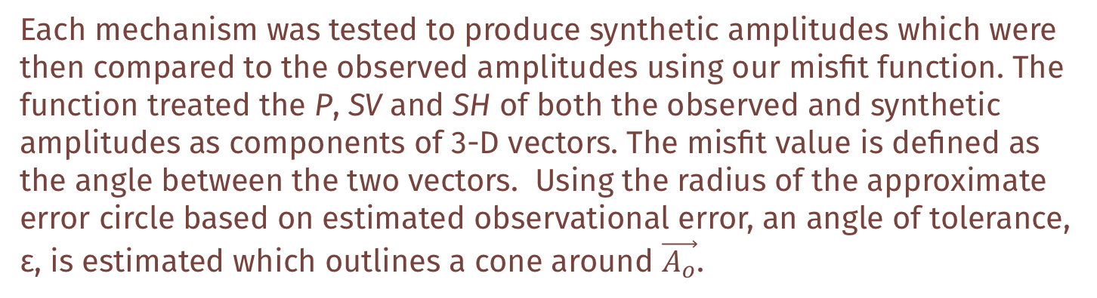

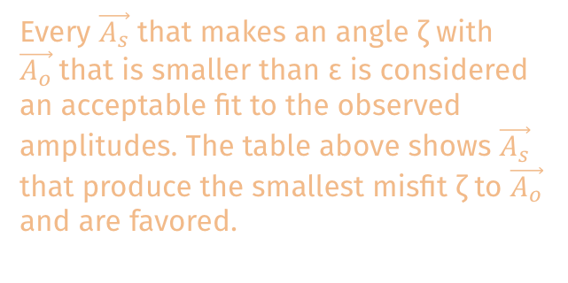
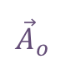


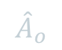
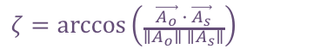
Origins and potential focal
mechanisms of three low-frequency marsquakes detected by a single InSight seismometer
Exploring the doublet Marsquake event
Investigating possible double-couple mechanisms
For S0173a, we found two different focal mechanisms for the beginning and end of a 4 second window. The two represent different modes of slip: reverse faulting and predominantly normal faulting. A linear combination of these two mechanisms produces a composite mechanism that resembles the source mechanism estimated by the InSight Team from waveform modeling¹.
Mars’ crust is composed of a single tectonic plate. Therefore, intraplate tectonics, such as faulting, and impacts are expected to be the major contributors to the seismicity of the planet^{2,3}. The lander is located about 1600km west of the Cerberus Fossae region, which is hypothesized to be an active tectonic structure and a major contributor to Mars’ seismicity^{4,5}.
Strike-Slip
Particle Motion
S0173a and S0235b were both found to fall in the Cerberus Fossae region while the epicenter of S0325ab is estimated to be near the boundary between the southern highland and the northern lowlands⁵. Our proposed faulting mechanisms shown below incorporated the information about these regions in our investigation.
[
Maddy Sita¹ & Suzan van der Lee²
We looked at the particle motion caused by the arrival of the P and S wave and found an apparent “movement” of the back azimuth angle over the time window.
This particle motion shows a doublet event containing both S0173a & S0173ab. Because of their proximity in arrival times, this doublet event likely was caused by two different mechanisms that bookend a 4 second time window.
¹ University of Virginia,² Northwestern University
[
[
S0235b
Normal
Reverse
Figure 2. S0173a begins at 0 seconds and the P- and S-wave arrival for S0173ab is at 4 seconds. The back azimuth angle shifts from 90° to 86°.
Grid Search
displacement (nm)
Using a modified version of the Gudkova model⁶ and an estimated source depth of 35km, we began modeling the SV, SH and P amplitudes that resulted from a range of double-couple focal mechanisms.
A grid search was then performed over a range of strike, dip and rake combinations to determine which could best reproduce the observed P, SH, and SV amplitudes. The best fitting fault plane orientations for each event is shown in Figure 3 below.
UTC2019-07-26T12:19:19
Distance: 27.5°
BAz: 74°
Event: | Strike: | Dip: | Rake: | Misfit:
S0173a | 46 | 38 | 148 | 0.396°
S0173ab | 30 | 48 | -12 | 0.241°
S0235b | 78 | 28 | 86 | 0.022°
S0325ab | 70 | 76 | -116 | 0.097°
S0173a
displacement (nm)
UTC2019-05-23T02:22:59
Adapting methods of fault plane determination
Distance: 29°
BAz: 90° & 86°
Each mechanism was tested to produce synthetic amplitudes which were then compared to the observed amplitudes using our misfit function. The function treated the P, SV and SH of both the observed and synthetic amplitudes as components of 3-D vectors. The misfit value is defined as the angle between the two vectors. Using the radius of the approximate error circle based on estimated observational error, an angle of tolerance, ε, is estimated which outlines a cone around $\vec{A_{o}}$.
S0325a
displacement (nm)
UTC2019-10-26T06:58:58
Distance: 38.5°
e
$${\vec{A}}_{o}$$
BAz: 139°
Possible Solutions
$$ε$$
Every $\vec{A_{s}}$ that makes an angle ζ with $\vec{A_{o}}$that is smaller than ε is considered an acceptable fit to the observed amplitudes. The table above shows $\vec{A_{s}}$ that produce the smallest misfit ζ to $\vec{A_{o}}$ and are favored.
$$ζ=\arccos\left(\frac{\vec{A_{o}} ∙ \vec{A_{s}}}{{∥A}_{o}∥ ∥A_{s}∥}\right)$$
$$ζ$$
$${\hat{A}}_{o}$$
$$ε=\arctan\left(\frac{e}{{∥A}_{o}∥}\right)$$
$${\vec{A}}_{s}$$
Figure 1. Rotated seismograms for each event are plotted relative to the arrival of the P-wave at time 0. The P- and S-wave arrival times are indicated by a vertical line and horizontal lines represent the synthetic amplitudes of the P, SH, and SV on the L, T and Q component respectively. Our favored double-couple mechanism modeled using the New Gudkova method at 35 km depth was used to calculate the synthetic waveform amplitudes.
Figure 3. The figure includes S0173a, S0173ab, S0235b and the new event S0325a at an approximate latitude and longitude of -15°N, 168°E in addition to their possible faulting mechanisms.
This material is based upon work supported by the National Science Foundation under Grant No. AST-1757792, a Research Experiences for Undergraduates (REU) grant awarded to CIERA at Northwestern University. Any opinions, findings, and conclusions or recommendations expressed in this material are those of the author(s) and do not necessarily reflect the views of the National Science Foundation.
1. Brinkman, N., Stähler, S. C., Giardini, D., Schmelzbach, C., Khan, A., Jacob, A., et al. (2021). First focal mechanisms of Marsquakes. Journal of Geophysical Research: Planets, 126, e2020JE006546.
2. Lognonné, P., Banerdt, W.B., Giardini, D. et al. SEIS: Insight’s Seismic Experiment for Internal Structure of Mars. Space Sci Rev 215, 12 (2019). https://doi.org/10.1007/s11214-018-0574-6
3. Banerdt, W.B., Smrekar, S.E., Banfield, D. et al. Initial results from the InSight mission on Mars. Nat. Geosci. 13, 183–189 (2020). https://doi.org/10.1038/s41561-020-0544-y
4. Taylor, J., Teanby, N. A., and Wookey, J. (2013), Estimates of seismic activity in the Cerberus Fossae region of Mars, J. Geophys. Res. Planets, 118, 2570– 2581, doi:10.1002/2013JE004469.
5. Giardini, D., Lognonné, P., Banerdt, W.B. et al. The seismicity of Mars. Nat. Geosci. 13, 205–212 (2020).
6. Zharkov, V.N., Gudkova, T.V. Construction of Martian Interior Model. Sol Syst Res 39, 343–373 (2005). https://doi.org/10.1007/s11208-005-0049-7

